Slide 1
ROS2 Tutorial for X-series Robotic Arms
Garrett Bowman

Slide 2
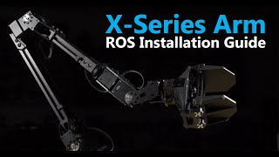

Installation
There are many different versions and ways to install ROS2. It is critical to pick a version that suits your Linux OS.
For this guide I will be using ROS2 by following instructions specifically for Trossen X-series Robotic Arms products on Ubuntu 20.04. https://www.trossenrobotics.com/docs/interbotix_xsarms/ros_interface/software_setup.html

Slide 3
Basic Functions
Node: Performs a specific task within the ROS system. Nodes can communicate with each other by publishing and subscribing to topics, offering and using services, or exchanging messages.
Publisher/Subscriber: Publishes data to a topic generally at a specific rate. Subscribers listen for data on a topic and performs action when new messages arrive.
Topic: Used for posting data and sharing information between nodes. Interacts with Publisher/subscriber nodes and can be listened to with
“ros2 topic echo”
Launch File: Startup process using only one file. We can define parameters and other configurations and let them automatically be applied. This creates a portable design/testing environment.

Slide 4
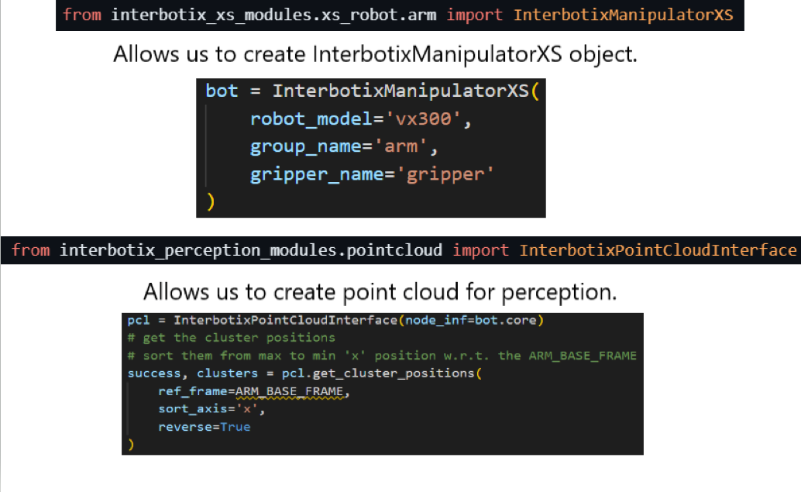
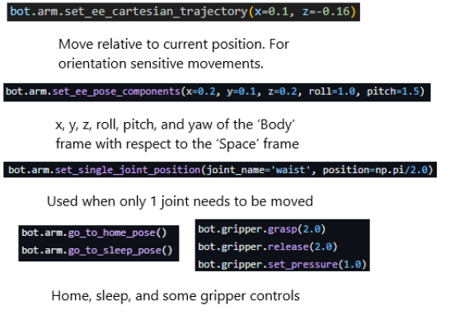
Writing a Python Script
This python script uses the interbotix_xsarm_control library.
Type: “ros2 launch interbotix_xsarm_control xsarm_control.launch.py robot_model:=vx300” in one terminal and then run python script “python3 scriptname.py” in another terminal.
MATLAB and C++ also supported.

Slide 5

Useful commands
Always “source ~/interbotix_ws/install/setup.bash” in terminal before performing any commands or add it to to the end of your ~/.bashrc file.
rqtgraph: Displays active nodes and how they are connected in an intuitive graphic
run/launch: Start node or launch file.
“ros2 run package node” or “ros2 run package launch_file.py”
Add parameters and arguments after this to specify program parameters etc.
node list/node info: View nodes currently running and get info on these nodes e.g. parameters, publications, subscriptions.
topic echo/topic pub: Manually subscribe or publish to a topic. Useful for debugging and testing.
param list/get/set/dump: Manipulate parameters and save them
service list/call: List services and request specific data from them
Do not forget to type ros2 before
any of these commands!

Slide 6
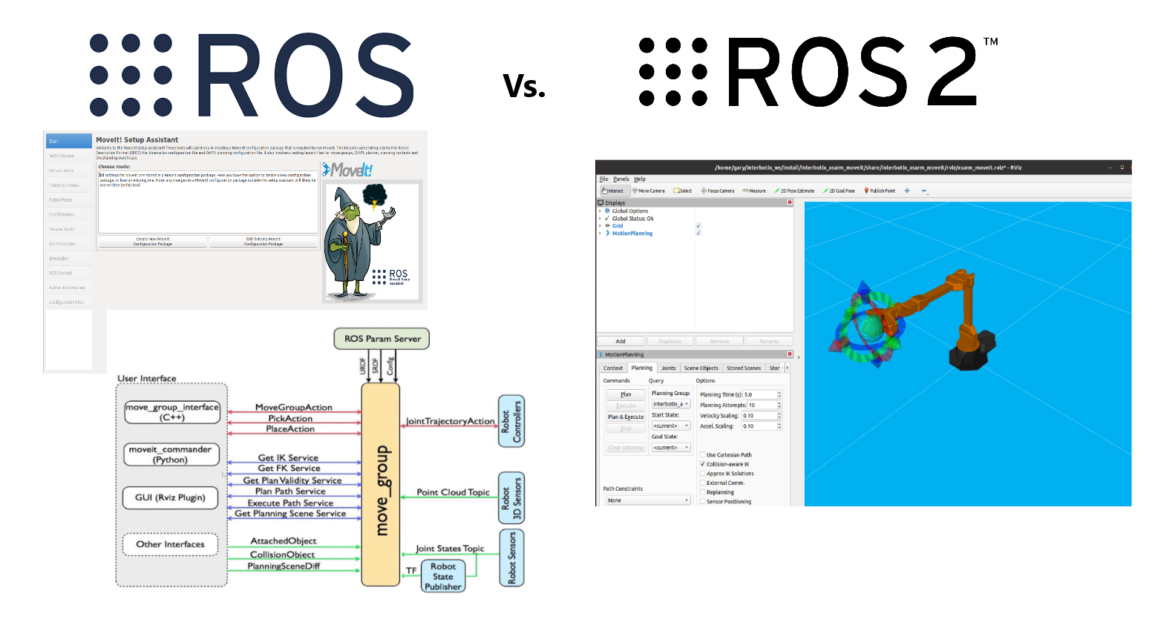
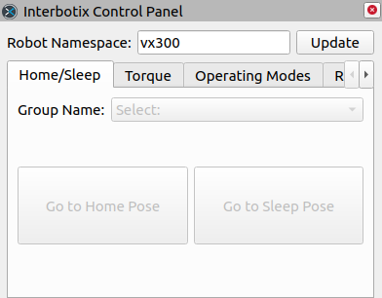
In ROS1, MoveIt Setup Assistant Wizard was used for each robot individually. In ROS2, the packages were merged into MoveIt 2 master launch file that can be used to create movements with a GUI.

Slide 7
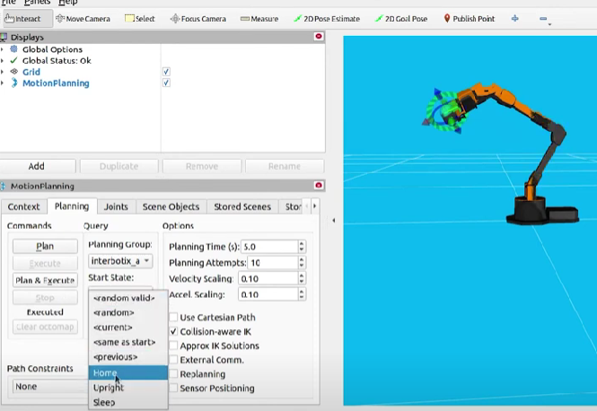
MoveIt 2 Motion Planning Configuration
To launch the GUI: “ros2 launch interbotix_xsarm_moveit xsarm_moveit.launch.py robot_model:=vx300 hardware_type:=actual”
Interbotix control panel with Rviz “ros2 launch interbotix_xsarm_control xsarm_control.launch.py robot_model:=vx300”
Many tutorials and examples available at: https://moveit.picknik.ai/main/doc/tutorials/tutorials.html

Slide 8
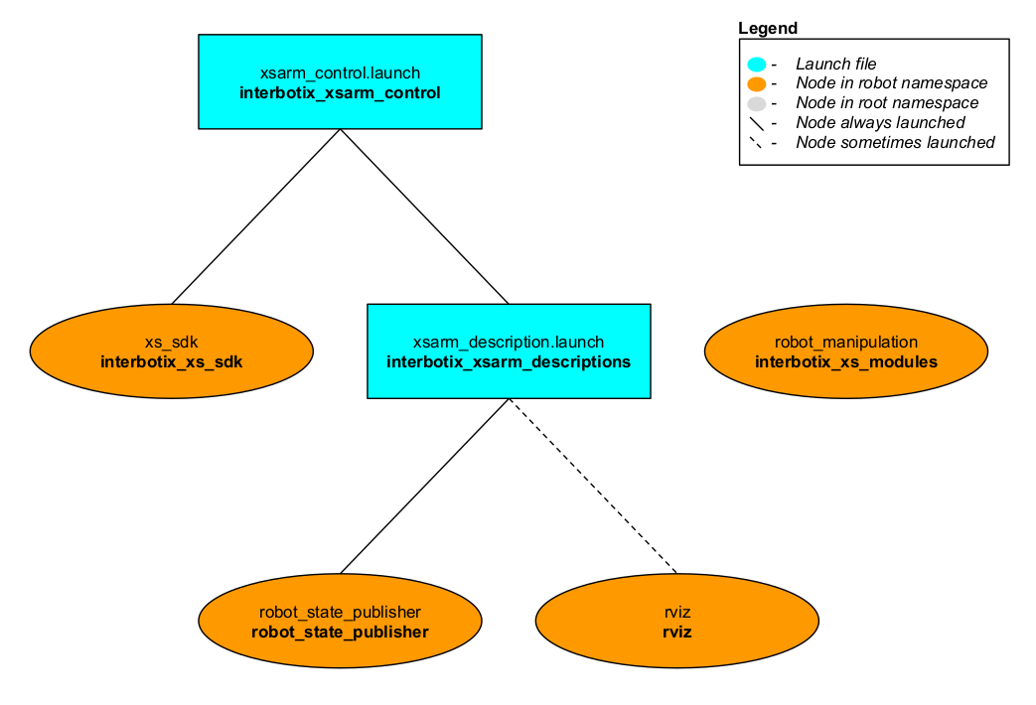
random

Slide 9
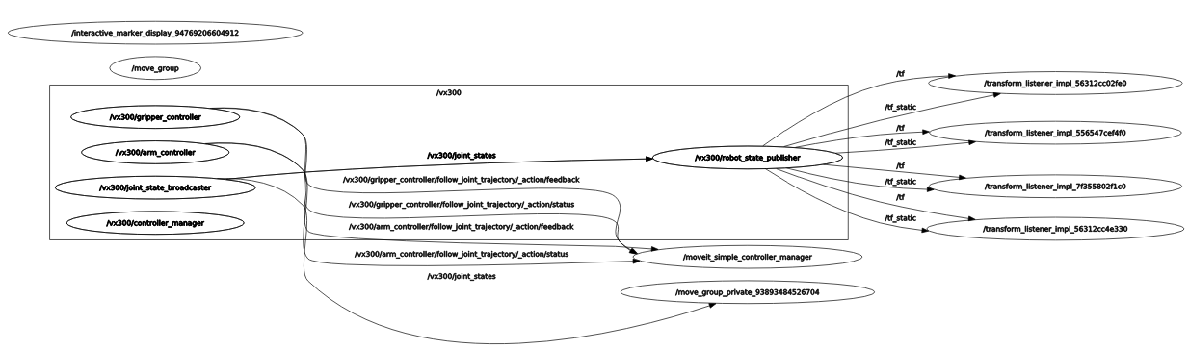

Slide 11
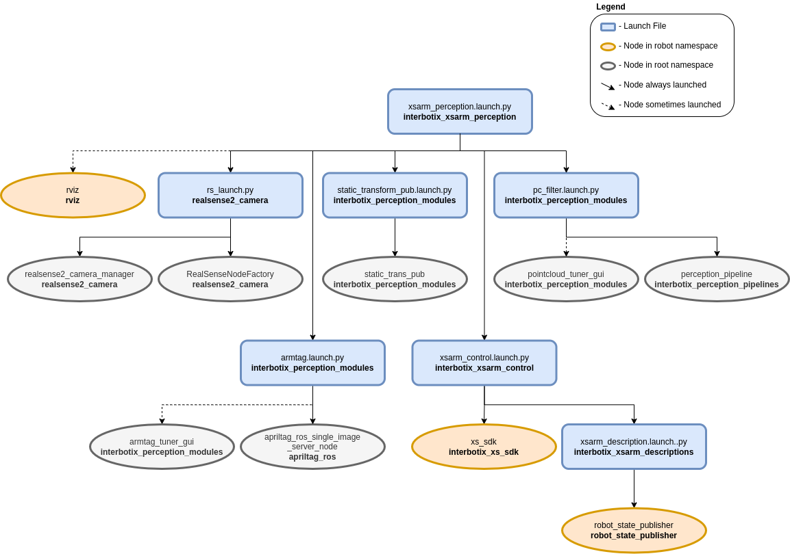
The Perception Pipeline

Slide 12
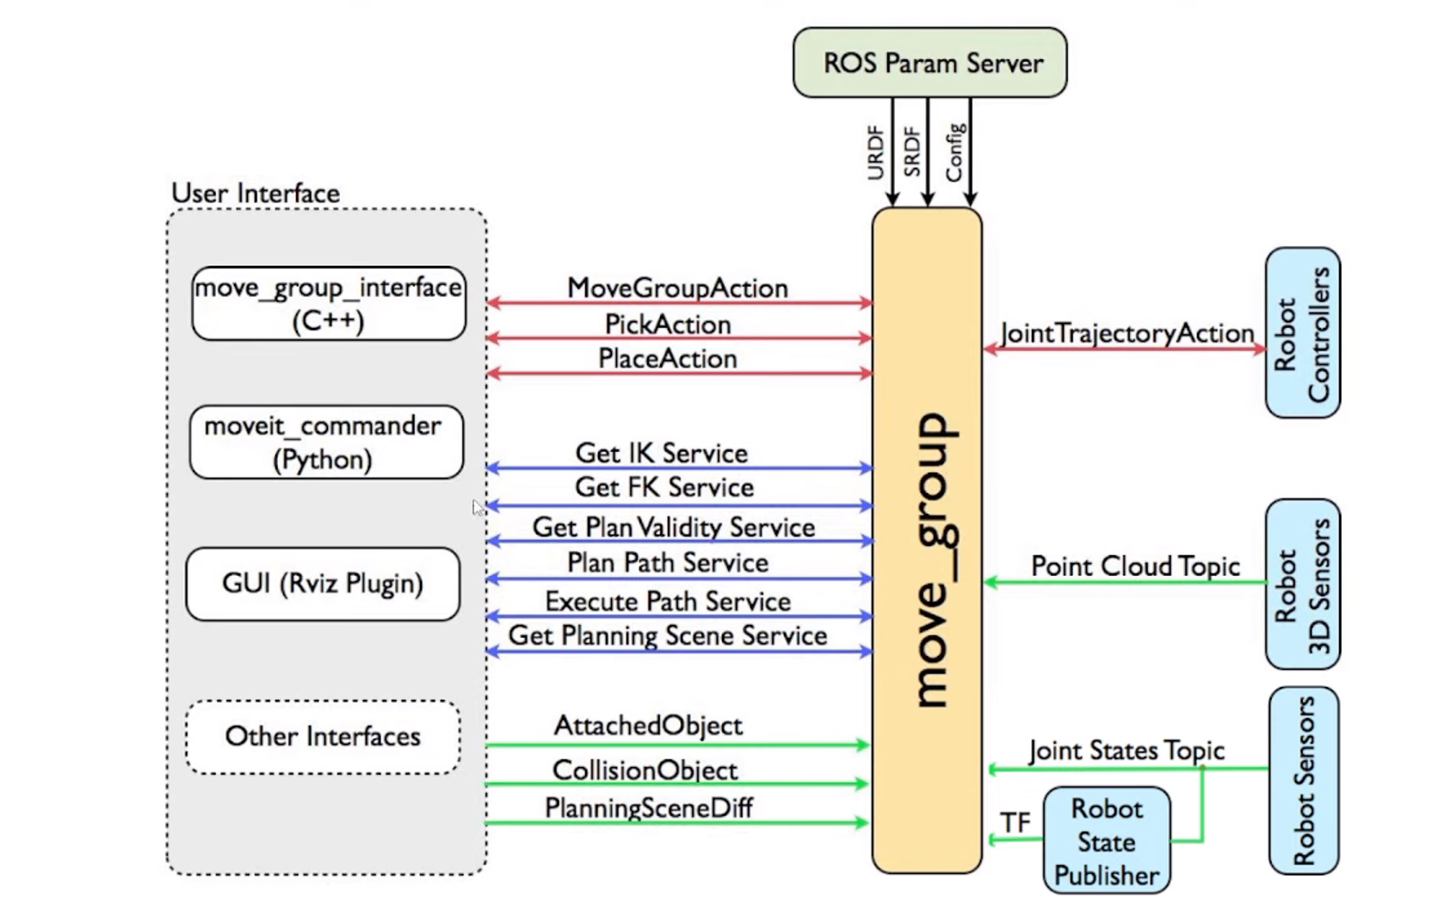
MoveIt Configuration Package (Outdated?)
MoveIt simplifies robotic movements by doing inverse kinematics calculations for us.
In ROS1, MoveIt Setup Assistant wizard was used for each robot individually. In ROS2, the packages were merged into one.
A 'master' launch file was then written to allow a user to choose whether to have MoveIt work with the simulated version, the physical robot hardware, or a MoveIt generated fake robot.

